Slide 1

Network Layer:
The Data Plane
All material copyright
J.F Kurose and K.W. Ross, All Rights Reserved
Notes:
Transport Layer provides process-to-process communication service
Network layer provides host-to-host communication service.
Unlike the transport and application layers, there is a piece of the network layer in each and every host and router in the network.

Slide 2
Set 4: outline
4.1 Overview of Network layer
data plane
control plane
4.2 What’s inside a router
4.3 IP: Internet Protocol
datagram format
fragmentation
IPv4 addressing
network address translation
IPv6

Slide 3
Chapter 4: network layer
goals:
understand principles behind network layer services, focusing on data plane:
network layer service models
forwarding versus routing
how a router works
generalized forwarding
instantiation, implementation in the Internet

Slide 4

















Network layer
transport segment from sending to receiving host
on sending side encapsulates segments into datagrams
on receiving side, delivers segments to transport layer
network layer protocols in every host, router
router examines header fields in all IP datagrams passing through it
application
transport
network
data link
physical
network
data link
physical
network
data link
physical
network
data link
physical
network
data link
physical
network
data link
physical
network
data link
physical
network
data link
physical
network
data link
physical
network
data link
physical
application
transport
network
data link
physical
network
data link
physical
network
data link
physical
Notes:
Note that the routers in Figure are shown with a truncated protocol stack, that is, with no upper layers above the network layer,
because routers do not run application- and transport-layer protocols

Slide 5
Two key network-layer functions
network-layer functions:
forwarding: move packets from router’s input to appropriate router output
routing: determine route taken by packets from source to destination
routing algorithms
analogy: taking a trip
forwarding: process of getting through single interchange
routing: process of planning trip from source to destination
Notes:
The primary role of the network layer is to move packets from a sending host to a receiving host. To do so, two important network-layer functions can be identified: forwarding and routing
Forwarding takes place at very short timescales (typically a few nanoseconds), and thus is typically implemented in hardware.
Routing takes place on much longer timescales (typically seconds), and as we will see is often implemented in software.

Slide 6
Network layer: data plane, control plane
Data plane
local, per-router function
determines how datagram arriving on router input port is forwarded to router output port
forwarding function
Control plane
network-wide logic
determines how datagram is routed among routers along end-end path from source host to destination host
two control-plane approaches:
traditional routing algorithms: implemented in routers
software-defined networking (SDN): implemented in (remote) servers
values in arriving
packet header
0111
1
3
2

Slide 7

Control plane: the traditional approach
Individual routing algorithm components in each and every router interact in the control plane
Routing
Algorithm
control
plane
data
plane
values in arriving
packet header
0111
1
3
2
Notes:
The routing algorithm function in one router communicates with the routing algorithm function in other routers to compute the values for its forwarding table.
How is this communication performed? By exchanging routing messages containing routing information according to a routing protocol!
Both forwarding and routing functions are contained within a router

Slide 8
Control plane: the SDN approach
A distinct (typically remote) controller interacts with local control agents (CAs)
Remote Controller
control
plane
data
plane
CA
CA
CA
CA
CA
values in arriving
packet header
0111
1
3
2
Notes:
A physically separate (from the routers), remote controller computes and distributes the forwarding tables to be used by each and every router.
The control-plane routing functionality is separated from the physical router—the routing device performs forwarding only, while the remote controller computes and distributes forwarding tables.
The controller that computes forwarding tables and interacts with routers is implemented in software, so the network is called “software-defined” network

Slide 9
Set 4: outline
4.1 Overview of Network layer
data plane
control plane
4.2 What’s inside a router
4.3 IP: Internet Protocol
datagram format
fragmentation
IPv4 addressing
network address translation
IPv6

Slide 10
Router architecture overview
high-level view of generic router architecture:
routing, management
control plane (software)
operates in millisecond
time frame
routing
processor
forwarding data plane (hardware) opertes in nanosecond timeframe
high-seed
switching
fabric
router input ports
router output ports

Slide 11
Destination-based forwarding
forwarding table
Destination Address Range
11001000 00010111 00010000 00000000
through
11001000 00010111 00010111 11111111
11001000 00010111 00011000 00000000
through
11001000 00010111 00011000 11111111
11001000 00010111 00011001 00000000
through
11001000 00010111 00011111 11111111
otherwise
Link Interface
0
1
2
3
Q: but what happens if ranges don’t divide up so nicely?

Slide 12
Longest prefix matching
longest prefix matching
when looking for forwarding table entry for given destination address, use longest address prefix that matches destination address.
Destination Address Range
11001000 00010111 00010*** *********
11001000 00010111 00011000 *********
11001000 00010111 00011*** *********
otherwise
Link interface
0
1
2
3
examples:
DA: 11001000 00010111 00010110 10100001
which interface?
DA: 11001000 00010111 00011000 10101010
which interface?

Slide 13
Switching fabrics
transfer packet from input buffer to appropriate output buffer
switching rate: rate at which packets can be transferred from inputs to outputs
often measured as multiple of input/output line rate
N inputs: switching rate N times line rate desirable
three types of switching fabrics
memory
memory
bus
crossbar

Slide 14
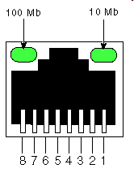
Switching via memory
first generation routers:
traditional computers with switching under direct control of CPU
packet copied to system’s memory
speed limited by memory bandwidth (2 bus crossings per datagram)
input
port
(e.g.,
Ethernet)
output
port
(e.g.,
Ethernet)
memory
system bus

Slide 15
Switching via a bus
datagram from input port memory
to output port memory via a shared bus
bus contention: switching speed limited by bus bandwidth
32 Gbps bus, Cisco 5600: sufficient speed for access and enterprise routers
bus

Slide 16
Switching via interconnection network
overcome bus bandwidth limitations
banyan networks, crossbar, other interconnection nets initially developed to connect processors in multiprocessor
advanced design: fragmenting datagram into fixed length cells, switch cells through the fabric.
Cisco 12000: switches 60 Gbps through the interconnection network
crossbar

Slide 17
Input port queuing
fabric is slower than input ports combined -> queueing may occur at input queues
queueing delay and loss due to input buffer overflow!
Head-of-the-Line (HOL) blocking: queued datagram at front of queue prevents others in queue from moving forward
switch
fabric
switch
fabric
output port contention:
only one red datagram can be transferred. lower red packet is blocked
one packet time later: green packet experiences HOL blocking
Notes:
Where Does Queuing Occur?
Packet queues may form at both the input ports and the output ports

Slide 18
Output ports
datagram
buffer
queueing
switch
fabric
link
layer
protocol
(send)
line
termination
buffering required when datagrams arrive from fabric faster than the transmission rate
scheduling discipline chooses among queued datagrams for transmission
Datagram (packets) can be lost due to congestion, lack of buffers
Priority scheduling – who gets best performance, network neutrality

Slide 19
Output port queueing
switch
fabric
switch
fabric
at t, packets more
from input to output
one packet time later
buffering when arrival rate via switch exceeds output line speed
queueing (delay) and loss due to output port buffer overflow!

Slide 20
Scheduling mechanisms
scheduling: choose next packet to send on link
FIFO (first in first out) scheduling: send in order of arrival to queue
real-world example?
discard policy: if packet arrives to full queue: who to discard?
tail drop: drop arriving packet
priority: drop/remove on priority basis
random: drop/remove randomly
packet
arrivals
packet
departures
queue
(waiting area)
link
(server)

Slide 21
Scheduling policies: priority
priority scheduling: send highest priority queued packet
multiple classes, with different priorities
class may depend on marking or other header info, e.g. IP source/dest, port numbers, etc.
real world example?
high priority queue
(waiting area)
arrivals
departures
classify
link
(server)
low priority queue
(waiting area)
2
1
3
4
5
arrivals
packet in service
1
3
2
4
5
departures
1
3
2
4
5

Slide 22
Scheduling policies: still more
Round Robin (RR) scheduling:
multiple classes
cyclically scan class queues, sending one complete packet from each class (if available)
real world example?
2
1
3
4
5
arrivals
packet in service
1
3
2
4
5
departures
1
3
3
4
5

Slide 23
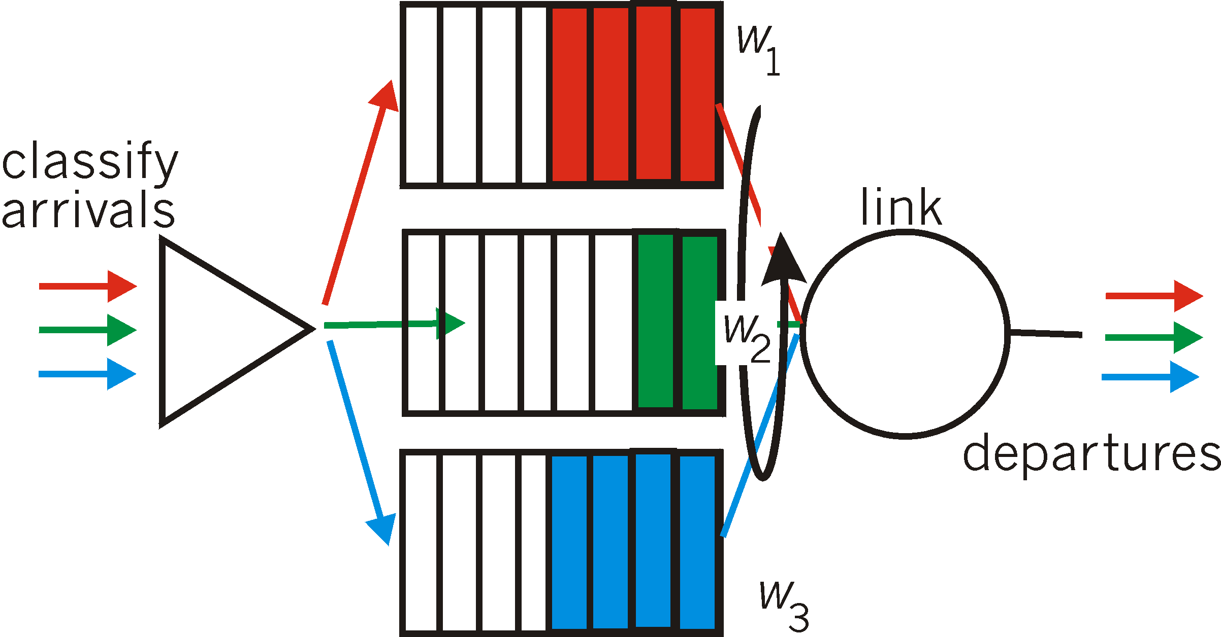
Scheduling policies: still more
Weighted Fair Queuing (WFQ):
generalized Round Robin
each class gets weighted amount of service in each cycle
real-world example?
Notes:
WFQ differs from round robin in that each class may receive a differential amount of service in any interval of time

Slide 24
Set 4: outline
4.1 Overview of Network layer
data plane
control plane
4.2 What’s inside a router
4.3 IP: Internet Protocol
datagram format
fragmentation
IPv4 addressing
network address translation
IPv6

Slide 25
The Internet network layer
host, router network layer functions:
transport layer: TCP, UDP
routing protocols
path selection
RIP, OSPF, BGP
IP protocol
addressing conventions
datagram format
packet handling conventions
network
layer
forwarding
table
ICMP protocol
error reporting
router “signaling”
link layer
physical layer
Notes:
RIP: Routing Information Protocol
OSPF: Open Shortest Path First
BGP: Border Gateway Protocol

Slide 26
IP datagram format
IP protocol version
number
32 bits
total datagram
length (bytes)
header length
(bytes)
head.
len
type of
service
ver
length
for
fragmentation/
reassembly
“type” of data
flgs
fragment
offset
16-bit identifier
max number
remaining hops
(decremented at
each router)
time to
live
upper
layer
header
checksum
32 bit source IP address
upper layer protocol
to deliver payload to
32 bit destination IP address
options (if any)
e.g. timestamp,
record route
taken, specify
list of routers
to visit.
data
(variable length,
typically a TCP
or UDP segment)
how much overhead?
20 bytes of TCP
20 bytes of IP
= 40 bytes + app layer overhead
Notes:
TOS: distinguish real-time datagrams (such as those used by an IP telephony application) from non-real-time traffic (for example, FTP).

Slide 27

IP fragmentation, reassembly
network links have MTU (max.transfer size) - largest possible link-level frame
different link types, different MTUs
large IP datagram divided (“fragmented”) within the network
one datagram becomes several datagrams
“reassembled” only at final destination
IP header bits used to identify, order related fragments
…
fragmentation:
in: one large datagram
out: 3 smaller datagrams
reassembly
…

Slide 28
IP fragmentation, reassembly
length
=4000
ID
=x
fragflag
=0
offset
=0
example:
4000 byte datagram
MTU = 1500 bytes
one large datagram becomes
several smaller datagrams
1480 bytes in data field
length
=1500
ID
=x
fragflag
=1
offset
=0
offset =
1480/8
length
=1500
ID
=x
fragflag
=1
offset
=185
length
=1040
ID
=x
fragflag
=0
offset
=370
IPv6 does not allow for fragmentation

Slide 29
Set 4: outline
4.1 Overview of Network layer
data plane
control plane
4.2 What’s inside a router
4.3 IP: Internet Protocol
datagram format
fragmentation
IPv4 addressing
network address translation
IPv6

Slide 30
IP addressing: introduction
223.1.1.1
IP address: 32-bit (v4) identifier for host/router interface
interface: connection between host/router and physical link
router’s typically have multiple interfaces
host typically has one or two interfaces (e.g., wired Ethernet, wireless 802.11)
IP addresses associated with each interface
223.1.2.1
223.1.1.2
223.1.1.4
223.1.2.9
223.1.1.3
223.1.3.27
223.1.2.2
223.1.3.1
223.1.3.2
223.1.1.1 = 11011111 00000001 00000001 00000001
223
1
1
1

Slide 31
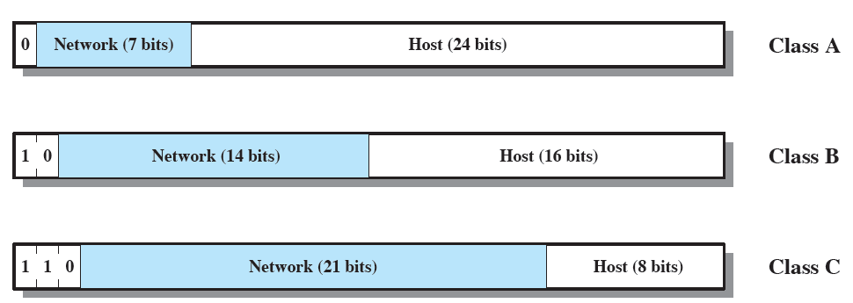
IP addressing
The source and destination address fields in the IP header each contains 32-bits global internet address, generally consisting of a network identifier and a host identifier
Class A: few networks, each with many hosts
Class B: Medium number of networks, each with a medium number of hosts
Class C: Many networks, each with a few hosts

Slide 32
IP addressing
IP addresses are written in dotted decimal notation, with a decimal number representing each of the octets of the 32-bit address. For example, the IP address 11000000 11100100 00010001 00111001 is written as 192.228.17.57
Class A network addresses begin with a binary 0. Network addresses with a first octet of 0 (binary 00000000) and 127 (binary 01111111) are reserved, so there are 126 potential Class A network numbers, which have a first dotted decimal number in the range 1 to 126
Class B network addresses begin with a binary 10, so that the range of the first decimal number in a Class B address is 128 to 191 (binary 10000000 to 10111111)
There are 2¹⁴ = 16,384 Class B network addresses
For Class C addresses, the first decimal number ranges from 192 to 223 (binary 11000000 to 11011111). The total number of Class C network addresses is 2²¹ = 2,097,152

Slide 33
Subnets and Subnet Masks
Consider an internet that includes one or more WANs and a number of sites, each of which has a number of LANs
We would like to insulate the overall internet against explosive growth in network numbers and routing complexity
Assign a single network number to ALL of the LANs at a site
Each LAN is assigned a subnet number
The host portion of the IP address is partitioned into a subnet number and a host number
The local router must route on the basis of an extended network number consisting of the network portion of the IP address and the subnet number
The address mask indicates the bit positions of this extended network number

Slide 34
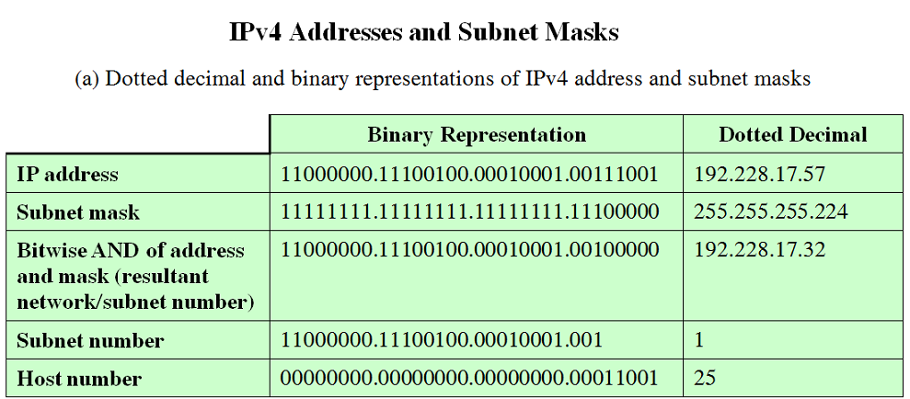
Subnets and Subnet Masks

Slide 35
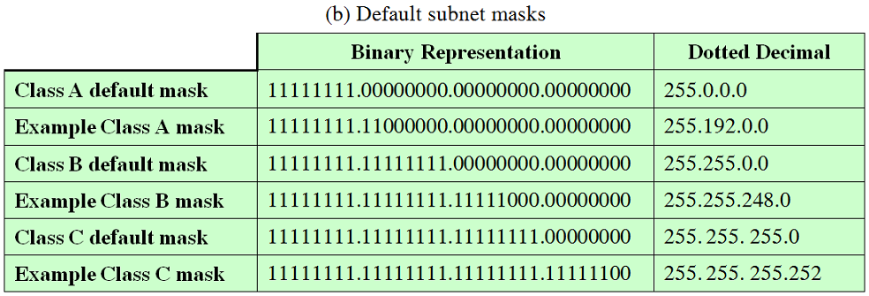
Subnets and Subnet Masks

Slide 36
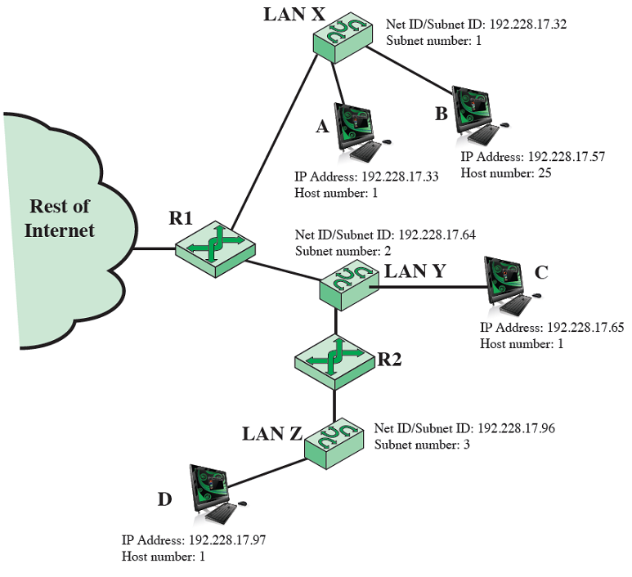
Subnets and Subnet Masks
Example of Subnetworking

Slide 37
Subnets
223.1.1.1
223.1.1.2
223.1.2.1
223.1.1.4
223.1.2.9
223.1.2.2
223.1.1.3
223.1.3.27
subnet
223.1.3.1
223.1.3.2
network consisting of 3 subnets

Slide 38
Subnets
223.1.1.2
how many?
223.1.1.1
223.1.1.4
6 subnets
223.1.1.3
223.1.9.2
223.1.7.0
223.1.9.1
223.1.7.1
223.1.8.1
223.1.8.0
223.1.2.6
223.1.3.27
223.1.2.1
223.1.2.2
223.1.3.1
223.1.3.2

Slide 39
Exercise
Exercise:
Given a network address of 192.168.100.0 and a subnet mask of 255.255.255.192,
a) How many subnets are created?
b) How many hosts are there per subnet?
Exercise:
Given a company with six individual departments and each department having ten computers or networked devices, what mask could be applied to the company network to provide the subnetting necessary to divide up the network equally?

Slide 40
IP addressing: CIDR
CIDR: Classless InterDomain Routing
subnet portion of address of arbitrary length
address format: a.b.c.d/x, where x is # bits in subnet portion of address
subnet
part
host
part
11001000 00010111 00010000 00000000
200.23.16.0/23
Notes:
Classless Interdomain Routing (CIDR—pronounced cider)

Slide 41
IP broadcast address
IP broadcast address 255.255.255.255
When a host sends a datagram with destination address 255.255.255.255, the message is delivered to all hosts on the same subnet.
Routers optionally forward the message into neighboring subnets as well (although they usually don’t).

Slide 42
IP addresses: how to get one?
Q: How does a host get IP address?
hard-coded by system admin in a file
Windows: control-panel->network->configuration->tcp/ip->properties
UNIX: /etc/rc.config
DHCP: Dynamic Host Configuration Protocol: dynamically get address from a server
“plug-and-play”
Notes:
A network administrator can configure DHCP so that a given host receives the same IP address each time it connects to the network, or a host may be assigned a temporary IP address that will be different each time the host connects to the network.

Slide 43
DHCP: Dynamic Host Configuration Protocol
goal: allow host to dynamically obtain its IP address from network server when it joins network
can renew its lease on address in use
allows reuse of addresses (only hold address while connected/“on”)
support for mobile users who want to join network (more shortly)
DHCP is a four-step process:
host broadcasts “DHCP discover” msg [optional]
DHCP server responds with “DHCP offer” msg [optional]
host requests IP address: “DHCP request” msg
DHCP server sends address: “DHCP Ack” msg

Slide 44


DHCP client-server scenario
DHCP
server
223.1.1.0/24
223.1.1.1
223.1.2.1
223.1.1.2
arriving DHCP
client needs
address in this
network
223.1.1.4
223.1.2.9
223.1.3.27
223.1.2.2
223.1.1.3
223.1.2.0/24
223.1.3.1
223.1.3.2
223.1.3.0/24

Slide 45
DHCP client-server scenario
DHCP server: 223.1.2.5
DHCP discover
arriving
client
src : 0.0.0.0, 68
dest.: 255.255.255.255,67
yiaddr: 0.0.0.0
transaction ID: 654
Broadcast: is there a DHCP server out there?
DHCP offer
src: 223.1.2.5, 67
dest: 255.255.255.255, 68
yiaddr: 223.1.2.4
transaction ID: 654
lifetime: 3600 secs
Broadcast: I’m a DHCP server! Here’s an IP address you can use
DHCP request
src: 0.0.0.0, 68
dest:: 255.255.255.255, 67
yiaddrr: 223.1.2.4
transaction ID: 655
lifetime: 3600 secs
Broadcast: OK. I’ll take that IP address!
DHCP ACK
src: 223.1.2.5, 67
dest: 255.255.255.255, 68
yiaddrr: 223.1.2.4
transaction ID: 655
lifetime: 3600 secs
Broadcast: OK. You’ve got that IP address!
Notes:
yiaddr: Your Internet Address

Slide 46
DHCP: more than IP addresses
DHCP can return more than just allocated IP address on subnet:
address of first-hop router for client
name and IP address of DNS sever
network mask (indicating network versus host portion of address)

Slide 47


DHCP: example
DHCP
DHCP
UDP
IP
Eth
Phy
connecting laptop needs its IP address, addr of first-hop router, addr of DNS server: use DHCP
DHCP
DHCP
DHCP
DHCP
DHCP request encapsulated in UDP, encapsulated in IP, encapsulated in 802.1 Ethernet
DHCP
DHCP
UDP
IP
Eth
Phy
168.1.1.1
DHCP
DHCP
DHCP
Ethernet frame broadcast (dest: FFFFFFFFFFFF) on LAN, received at router running DHCP server
DHCP
router with DHCP
server built into
router
Ethernet demuxed to IP demuxed, UDP demuxed to DHCP

Slide 48
DHCP: example
DHCP
UDP
IP
Eth
Phy
DHCP server formulates DHCP ACK containing client’s IP address, IP address of first-hop router for client, name & IP address of DNS server
DHCP
DHCP
DHCP
DHCP
encapsulation of DHCP server, frame forwarded to client, demuxing up to DHCP at client
DHCP
DHCP
UDP
IP
Eth
Phy
DHCP
DHCP
DHCP
router with DHCP
server built into
router
client now knows its IP address, name and IP address of DSN server, IP address of its first-hop router
DHCP

Slide 49
DHCP: Wireshark output (home LAN)
reply
Message type: Boot Reply (2)
Hardware type: Ethernet
Hardware address length: 6
Hops: 0
Transaction ID: 0x6b3a11b7
Seconds elapsed: 0
Bootp flags: 0x0000 (Unicast)
Client IP address: 192.168.1.101 (192.168.1.101)
Your (client) IP address: 0.0.0.0 (0.0.0.0)
Next server IP address: 192.168.1.1 (192.168.1.1)
Relay agent IP address: 0.0.0.0 (0.0.0.0)
Client MAC address: Wistron_23:68:8a (00:16:d3:23:68:8a)
Server host name not given
Boot file name not given
Magic cookie: (OK)
Option: (t=53,l=1) DHCP Message Type = DHCP ACK
Option: (t=54,l=4) Server Identifier = 192.168.1.1
Option: (t=1,l=4) Subnet Mask = 255.255.255.0
Option: (t=3,l=4) Router = 192.168.1.1
Option: (6) Domain Name Server
Length: 12; Value: 445747E2445749F244574092;
IP Address: 68.87.71.226;
IP Address: 68.87.73.242;
IP Address: 68.87.64.146
Option: (t=15,l=20) Domain Name = "hsd1.ma.comcast.net."
Message type: Boot Request (1)
Hardware type: Ethernet
Hardware address length: 6
Hops: 0
Transaction ID: 0x6b3a11b7
Seconds elapsed: 0
Bootp flags: 0x0000 (Unicast)
Client IP address: 0.0.0.0 (0.0.0.0)
Your (client) IP address: 0.0.0.0 (0.0.0.0)
Next server IP address: 0.0.0.0 (0.0.0.0)
Relay agent IP address: 0.0.0.0 (0.0.0.0)
Client MAC address: Wistron_23:68:8a (00:16:d3:23:68:8a)
Server host name not given
Boot file name not given
Magic cookie: (OK)
Option: (t=53,l=1) DHCP Message Type = DHCP Request
Option: (61) Client identifier
Length: 7; Value: 010016D323688A;
Hardware type: Ethernet
Client MAC address: Wistron_23:68:8a (00:16:d3:23:68:8a)
Option: (t=50,l=4) Requested IP Address = 192.168.1.101
Option: (t=12,l=5) Host Name = "nomad"
Option: (55) Parameter Request List
Length: 11; Value: 010F03062C2E2F1F21F92B
1 = Subnet Mask; 15 = Domain Name
3 = Router; 6 = Domain Name Server
44 = NetBIOS over TCP/IP Name Server
……
request

Slide 50
IP addresses: how to get one?
Q: how does network get subnet part of IP addr?
A: gets allocated portion of its provider ISP’s address space
ISP's block 11001000 00010111 00010000 00000000 200.23.16.0/20
Organization 0 11001000 00010111 00010000 00000000 200.23.16.0/23
Organization 1 11001000 00010111 00010010 00000000 200.23.18.0/23
Organization 2 11001000 00010111 00010100 00000000 200.23.20.0/23
... ….. …. ….
Organization 7 11001000 00010111 00011110 00000000 200.23.30.0/23
Notes:
Now after knowing how the host gets its IP address on a network. The question is how to obtain a block of IP addresses for use within an organization’s subnet?
A network administrator might first contact its ISP, which would provide addresses from a larger block of addresses that had already been allocated to the ISP
For example, the ISP may itself have been allocated the address block 200.23.16.0/20

Slide 51
IP addressing: the last word...
Q: how does an ISP get block of addresses?
A: ICANN: Internet Corporation for Assigned
Names and Numbers http://www.icann.org/
allocates addresses
manages DNS
assigns domain names, resolves disputes

Slide 52
NAT: network address translation
rest of
Internet
local network
(e.g., home network)
10.0.0/24
10.0.0.1
10.0.0.4
10.0.0.2
138.76.29.7
10.0.0.3
all datagrams leaving local
network have same single source NAT IP address: 138.76.29.7,different source port numbers
datagrams with source or
destination in this network
have 10.0.0/24 address for
source, destination (as usual)
Notes:
NAT: is the process of mapping private IP addresses to public address

Slide 53
NAT: network address translation
motivation: local network uses just one IP address as far as outside world is concerned:
range of addresses not needed from ISP: just one IP address for all devices
can change addresses of devices in local network without notifying outside world
can change ISP without changing addresses of devices in local network
devices inside local net not explicitly addressable, visible by outside world (a security plus)

Slide 54
NAT: network address translation
implementation: NAT router must:
outgoing datagrams: replace (source IP address, port #) of every outgoing datagram to (NAT IP address, new port #)
. . . remote clients/servers will respond using (NAT IP address, new port #) as destination addr
remember (in NAT translation table) every (source IP address, port #) to (NAT IP address, new port #) translation pair
incoming datagrams: replace (NAT IP address, new port #) in dest fields of every incoming datagram with corresponding (source IP address, port #) stored in NAT table

Slide 55
NAT: network address translation
NAT translation table
WAN side addr LAN side addr
2: NAT router
changes datagram
source addr from
10.0.0.1, 3345 to
138.76.29.7, 5001,
updates table
1: host 10.0.0.1
sends datagram to
128.119.40.186, 80
138.76.29.7, 5001 10.0.0.1, 3345
…… ……
S: 10.0.0.1, 3345
D: 128.119.40.186, 80
10.0.0.1
1
2
S: 138.76.29.7, 5001
D: 128.119.40.186, 80
10.0.0.4
10.0.0.2
138.76.29.7
S: 128.119.40.186, 80
D: 10.0.0.1, 3345
4
S: 128.119.40.186, 80
D: 138.76.29.7, 5001
3
10.0.0.3
4: NAT router
changes datagram
dest addr from
138.76.29.7, 5001 to 10.0.0.1, 3345
3: reply arrives
dest. address:
138.76.29.7, 5001
* Check out the online interactive exercises for more examples: http://gaia.cs.umass.edu/kurose_ross/interactive/
Notes:
5001, 3345, 80 are port numbers

Slide 56
NAT: network address translation
16-bit port-number field:
60,000 simultaneous connections with a single LAN-side address!
NAT is controversial:
routers should only process up to layer 3
address shortage should be solved by IPv6
violates end-to-end argument
NAT possibility must be taken into account by app designers, e.g., P2P applications
NAT traversal: what if client wants to connect to server behind NAT?

Slide 57
Set 4: outline
4.1 Overview of Network layer
data plane
control plane
4.2 What’s inside a router
4.3 IP: Internet Protocol
datagram format
fragmentation
IPv4 addressing
network address translation
IPv6

Slide 58
IPv6: motivation
initial motivation: 32-bit address space soon to be completely allocated.
additional motivation:
header format helps speed processing/forwarding
header changes to facilitate QoS
IPv6 datagram format:
fixed-length 40 byte header
no fragmentation allowed
Notes:
If an IPv6 datagram received by a router is too large to be forwarded over the outgoing link, the router simply drops the datagram and sends a “Packet Too Big” ICMP error message back to the sender. The sender can then resend the data, using a smaller IP datagram size.
Fragmentation and reassembly is a time-consuming operation; removing this functionality from the routers and placing it squarely in the end systems considerably speeds up IP forwarding within the network.

Slide 59
IPv6 datagram format
priority: identify priority among datagrams in flow
flow Label: identify datagrams in same “flow.”
(concept of“flow” not well defined).
next header: identify upper layer protocol for data
ver
pri
flow label
payload len
next hdr
hop limit
source address
(128 bits)
destination address
(128 bits)
data
32 bits

Slide 60
Other changes from IPv4
checksum: removed entirely to reduce processing time at each hop
options: allowed, but outside of header, indicated by “Next Header” field
ICMPv6: new version of ICMP
additional message types, e.g. “Packet Too Big”
multicast group management functions

Slide 61
Transition from IPv4 to IPv6
not all routers can be upgraded simultaneously
no “flag days”
how will network operate with mixed IPv4 and IPv6 routers?
tunneling: IPv6 datagram carried as payload in IPv4 datagram among IPv4 routers
IPv4 header fields
IPv6 header fields
IPv4 payload
IPv4 source, dest addr
IPv6 source dest addr
UDP/TCP payload
IPv6 datagram
IPv4 datagram

Slide 62
Tunneling
A
B
IPv4 tunnel
connecting IPv6 routers
E
F
logical view:
IPv6
IPv6
IPv6
IPv6
A
B
C
D
E
F
physical view:
IPv6
IPv6
IPv4
IPv4
IPv6
IPv6

Slide 63
Tunneling
A
B
IPv4 tunnel
connecting IPv6 routers
E
F
logical view:
IPv6
IPv6
IPv6
IPv6
A
B
C
D
E
F
physical view:
IPv6
IPv6
IPv4
IPv4
IPv6
IPv6
flow: X
src: A
dest: F
data
src:B
dest: E
src:B
dest: E
flow: X
src: A
dest: F
data
Flow: X
Src: A
Dest: F
data
Flow: X
Src: A
Dest: F
data
A-to-B:
IPv6
B-to-C:
IPv6 inside
IPv4
B-to-C:
IPv6 inside
IPv4
E-to-F:
IPv6

Slide 64
IPv6 Addresses
The IPv6 addresses are represented by a sequence of 8 4-hexadecimal numbers divided by colons, for example
2001:0DB8:0055:0000:CD23:0000:0000:0205
2001:0DB8:55:0:CD23:0:0:0205
2001:0DB8:55::CD23:0:0:0205 OR 2001:0DB8:55:0:CD23::0205 (consecutive groups of all zeros can be substituted by a double colon, but this may be done once in the address)

Slide 65
IPv6: adoption
Google: ~30% of clients access services via IPv6
NIST: 1/3 of all US government domains are IPv6 capable
Long (long!) time for deployment, use
25 years and counting!
think of application-level changes in last 25 years: WWW, Facebook, streaming media, Skype, …
Why?
it is very difficult to change network-layer protocols
introducing new protocols into the network layer is like replacing the foundation of a house

Slide 66
Set 4: done!
4.1 Overview of Network layer: data plane and control plane
4.2 What’s inside a router
4.3 IP: Internet Protocol
datagram format
fragmentation
IPv4 addressing
NAT
IPv6
Question: how do forwarding tables computed?
Answer: by the control plane (next set)

